Slide 1

HTML5 & CSS3
Fundamentals
Week 1 – Full-Stack DPP Course

Slide 2
Welcome
Manuel Cubuca
Technical Trainer
Email: manuelc@justit.co.uk
Official LinkedIn

Slide 3

Classroom Rules
There are no rules – we all adults
Just respect each other
Work together
Collaborate and create lasting friendships

Slide 4
Health & Safety
If you feel unwell please let me know
Info about the building
Careful with cables and drinks
Get breaks away from the screen
Make sure you comfortable

Slide 5
Class Structure
Start at 9:30am
Break in between (10-15 min)
Lunch break at 1pm (for an hour)
Break in between (10-15 min)
We finish at 4:30pm

Slide 6
Week 1 Overview
HTML5 and CSS3
The fundamentals of the HTML5 and CSS3 Mark-up language. We will use a case study to apply the most commonly used HTML5 and CSS3 features and a very small part of jQuery for webpage interactivity.

Slide 7
Week 1 Overviewcont.
Our aim
At the end of this week it is anticipated you will have the knowledge and skills to independently hand code webpages from scratch using HTML5 and CSS3, apply interactivity with jQuery and make webpages responsive with Media Queries. We also anticipate you will gain the knowledge to extend beyond this in the future.

Slide 8
Part 1 Outline
Open an Hosting Account with one.com
GitHub Account
HTML5 Overview
Building the Skeleton
Styling with CSS
Interactivity
Media Queries

Slide 9
Part 1 Learning Objectives
Learners would have a good understanding of:
What HTML5 is
Create webpage structure from scratch
Create and deploy HTML5 structure tags
Basics of CSS
Page layout with CSS and CSS3
jQuery code snippets for webpage interactivity
Introduction to media queries and how to build responsive webpages for mobile devices

Slide 10
What is our training approach
Great believer that practice makes better and also you learn better by doing.
HANDS ON CODING

Slide 11

Practice and Practice…

Slide 12

The Queen’s Chair

Slide 13
Hosting account and GitHub
First things first, I will guide you to open a one.com hosting account and also buy a domain name. Once that is done we will create a FREE account with GitHub.
https://app.pluralsight.com/library/courses/github-windows-developers/table-of-contents
ONE.COM
GitHub

Slide 14



The Web Development Trifecta
HTML5 – structures and describes Web page content
CSS3 – provides the formatting and "look" of a Web page
JavaScript – adds interactive, dynamic capabilities to Web pages

Slide 15
What is HTML5?
Is a collection of standards including CSS3 and JavaScript are part of the new definition:
HTML5 is the newest version of HTML and replaces HTML4
Eliminates the need and use of plugins such as flash and Silverlight
HTML5 is cross platform application
Visit the W3C website for
HTML5 History

Slide 16
HTML5 New Features
New elements and attributes
Support for CSS3
New form controls
Video and audio integration
Graphics using Canvas
SVG
Drag and drop
Web storage
Geolocation

Slide 17
HTML5 New Semantic Elements (block elements)
Full list of HTML tags: https://www.w3schools.com/tags/
Section
Nav
Header
Article
Footer
Aside
Figure
Figcaption
Address
Video and Audio
Canvas
Summary and Details

Slide 18
HTML5 New Semantic Elements (inline elements)
Full list of HTML tags:
https://www.w3schools.com/tags/
Mark
Meter
Progress
Output
Time

Slide 19
Resources
Pluralsight video tutorials
HTML & CSS (book)
W3 Schools
CSS3 Tricks
Stack Overflow

Slide 20
Building our case study
Access my GitHub account and download the HTML5&CSS3 Part1 folder
https://github.com/biatoSalo

Slide 21
Where and how do I start?
In house rules, it depends of the company you will be working for

Slide 22
Mockups or Wireframes
Full screen background image
Main navigation
Main logo
Call for action
I

Slide 23
Mockups or Wireframes
Product picture
Product picture
Product picture
Product picture
Product picture
Product picture

Slide 24
Mockups or Wireframes
Product picture
Product picture
Product picture
Shopping Cart
Product picture
Product picture
Product picture
Delivery features and options

Slide 25
Mockups or Wireframes
Contact form
Google Maps for location
Address and social media

Slide 26
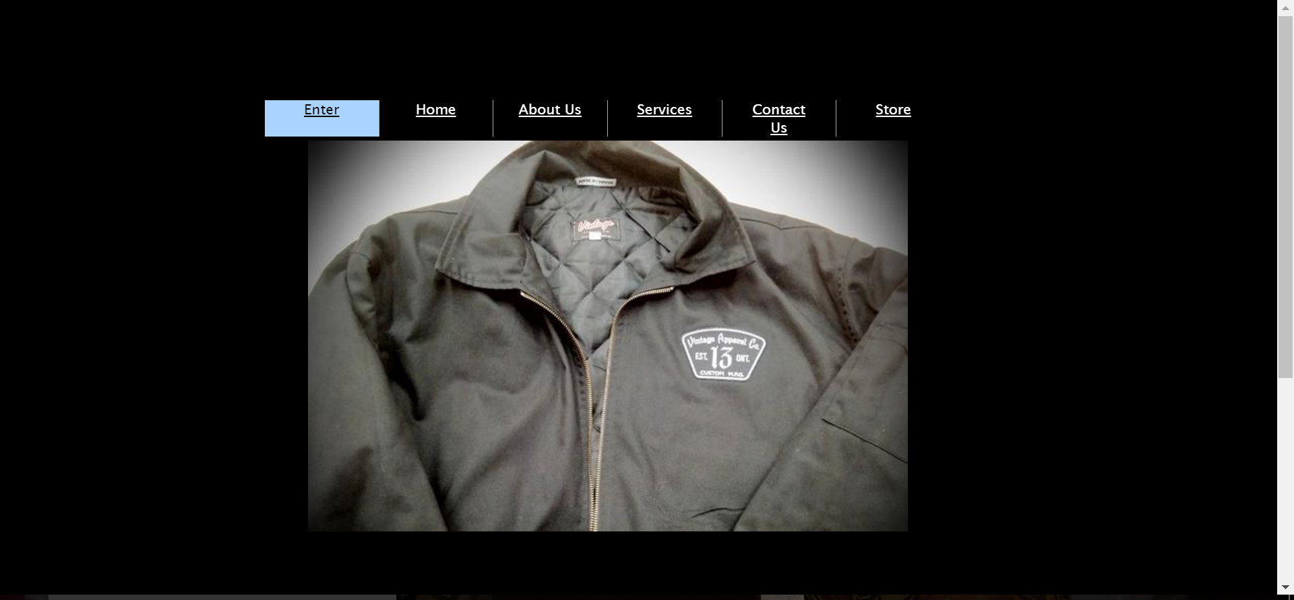
What we are updating
The Vintage Apparel Company:

Slide 27
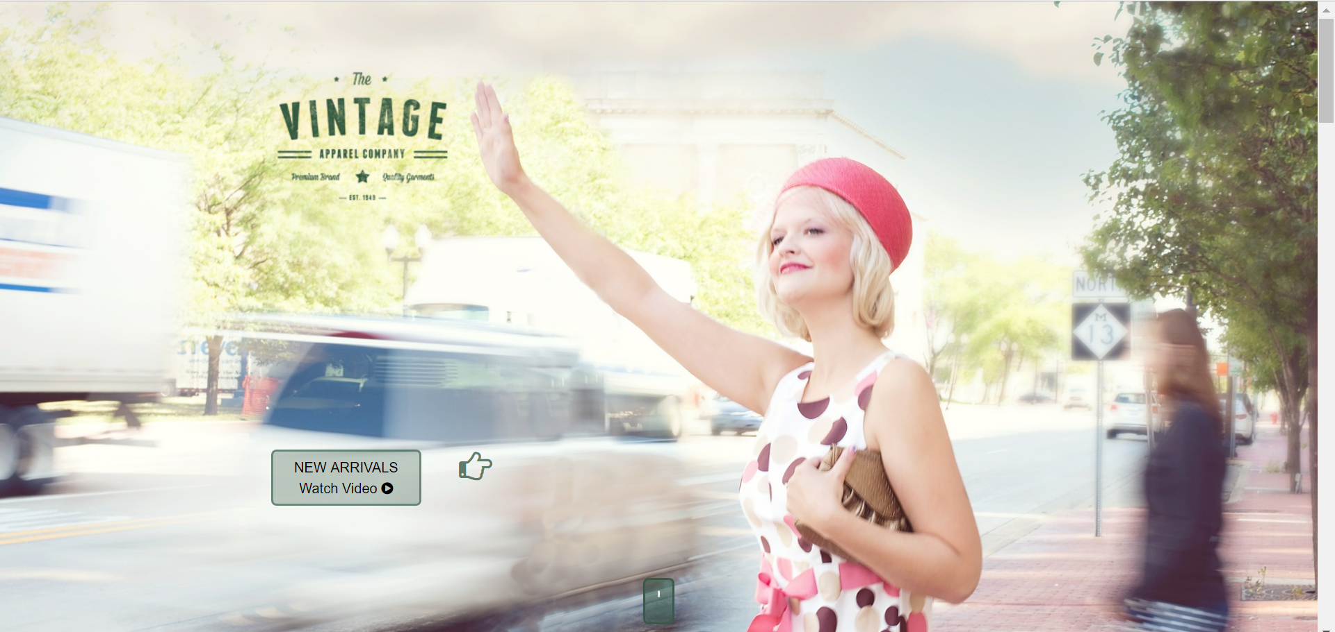
Hand coding from scratch
Modern, user friendly, interactive and responsive:

Slide 28
CSS the Basics
CSS: Cascading Style Sheets
We can separate mark-up and styling code
Link our styles to our webpage
Manipulate the layout of our webpage
Style different elements within our webpage
CSS3 History

Slide 29
CSS the Basics
CSS: Cascading Style Sheets
The best way to work with CSS is to link it into our head section of our html document
<head>
<link rel="stylesheet" type="text/css" href="css/myStyles.css“ />
</head>

Slide 30
CSS the Basics
CSS is composed of rules:
The Selector
The Declaration
Selector {
property: propertyValue;
}
p {
color: red;
}

Slide 31
CSS Selectors
p { color: red; }
Tag name
Class name
Element ID
Combine selector
Child selector
.productBox { width: 200px; }
#productID { font-size: 2em; }
.p.productSize { font-size: 2em; }
.productSize a { font-size: 2em; }
.productSize > a { font-size: 2em; }

Slide 32
CSS Selectors
a: link { color: blue; }
a: visited { color: yellow; }
a: hover { color: brown; }
a: active { color: white; }
Pseudo classes
Pseudo elements
p: first-child { color: red; }

Slide 33
Common CSS Properties
h2 { color: #444444; }
Color
Background
Background-colour
Background-image
Background-position
Can use shorthand
Text and fonts
footer { background-color: black; }
footer { background-color: black url(“pic1.jpg”) no-repeat fixed center; }
p { font-size: 2em; }

Slide 34
The CSS Box Model
Margin
Border
Padding
Content

Slide 35
Page Layout with CSS
CSS can specify how an element will be positioned
Inline:
The element should be displayed next to each other
<span>, <br>, <img>, <a>, <td>
Block:
They start on a new line and will take all the space it can horizontally, new content goes beneath
<div>, <h1>, <p>, <section>, <ul>, <article>, <nav>

Slide 36
Page Layout with CSS
Float:
The browser will ignore the normal flow to place elements at the left or right of the content
It’s value can be left, right or none
Clear:
Stops the browser to set elements on the left or right of the content
Can also have the values left, right or none

Slide 37
Page Layout with CSS
Header (normal flow)
Sidebar
(float left)
Content (float left)
Footer (clear both)

Slide 38







Why should I learn JavaScript
JavaScript is rapidly taking over as the programming language for the Web, with very popular JS Frameworks.
Have you heard about Apache Cordova?

